Slide 1
Global PSP Project for Indian Embassies and Consulates
Quick Guide – Cancel Passport

Slide 2
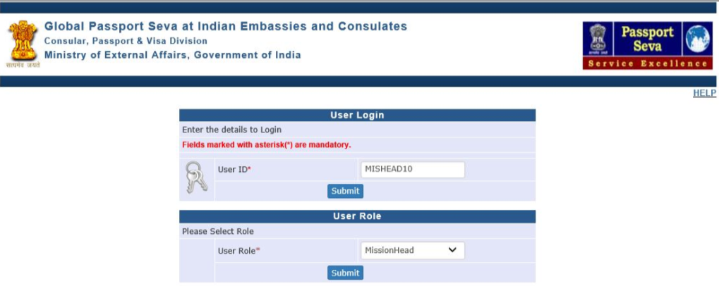
Login Using User ID, Password, and Grid Values
Visit Global PSP Office Portal (https://embassy.passportindia.gov.in)
Enter User ID
Press Submit button
Choose User Role as ‘MissionHead’ or ‘PIA’ role
Press Submit button displayed below the User Role

Slide 3
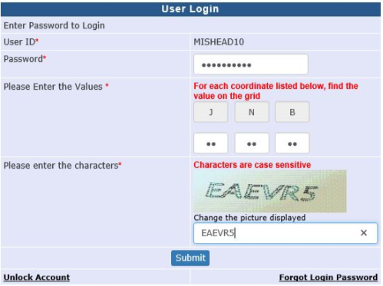
Login Using User ID, Password, and Grid Values (continued..)
Enter Password
Check your User Grid and enter the values for the three alphabets displayed on the screen
Enter the characters displayed in the CAPTCHA image
Press Submit button

Slide 4
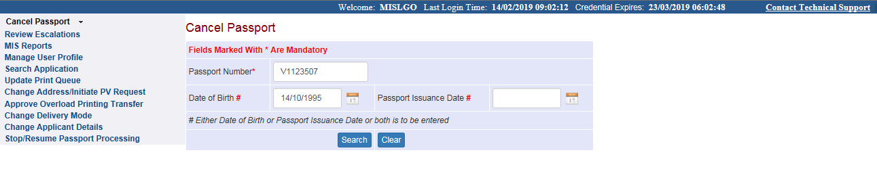
Cancel Passport
Click on the Link 'Cancel Passport’ displayed in the Left Menu
Enter Passport Number and “Date of Birth” or “Date of Issuance”.
Search button.

Slide 5
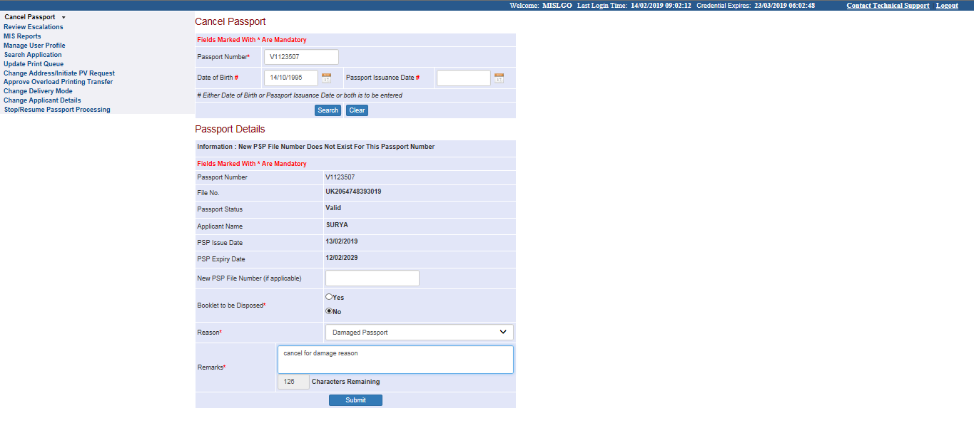
Cancel Passport Screen (continued..)
The details of the passport will be displayed
Please select “Booklet to be Disposed” as Yes/No .
Select “Reason" of cancellation and enter Remarks.
Press Submit Button.

Slide 6
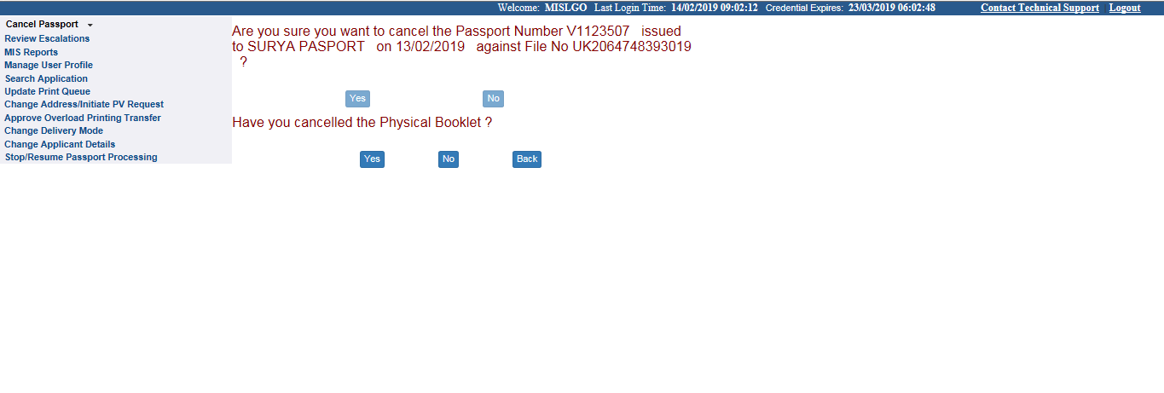
Cancel Passport Screen (continued..)
Press Yes for confirming the cancellation of passport otherwise press No.
Press Yes/No for physical cancellation of the passport.

Slide 7
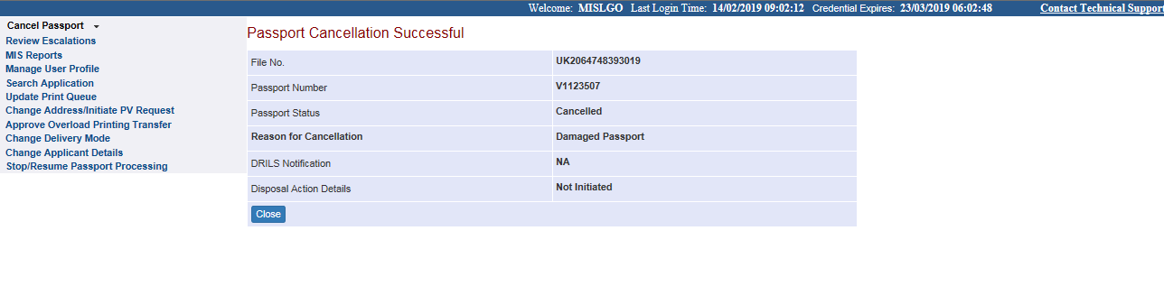
Cancel Passport Success Screen
Final successful screen of passport Cancellation will be displayed.

Slide 8
In case of additional information or clarification, please contact Global PSP Support Team at
Email : global.psp@tcs.com
Phone : +91-0120-672-9595/96
Mobile : +91-730-351-9595
Thank You

